Slide 1

React Session 1
29/09/2023
Plan and Setup
Code Mentor Mauritius - React Sessions – Full Stack Web Development

Slide 2
Agenda
Folder structure
Setup
Basics
Code Mentor Mauritius - React Sessions – Full Stack Web Development

Slide 3
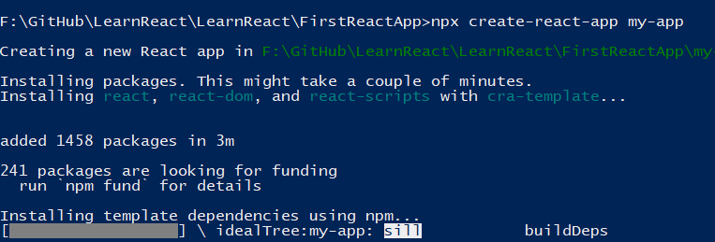
Creating a React App
npx create-react-app appName
Start React project
npm start
Create React App (create-react-app.dev)
Code Mentor Mauritius - React Sessions – Full Stack Web Development

Slide 4
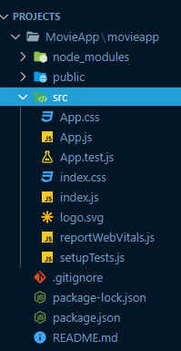
Folder structure
src contains all logic for our code
Public folder contains one html file with one div <div id="root"></div> where react content is injected
In index.js, we have 1 react.dom. createRoot call
In App.js, we have a functional component with jsx code
Code Mentor Mauritius - React Sessions – Full Stack Web Development

Slide 5
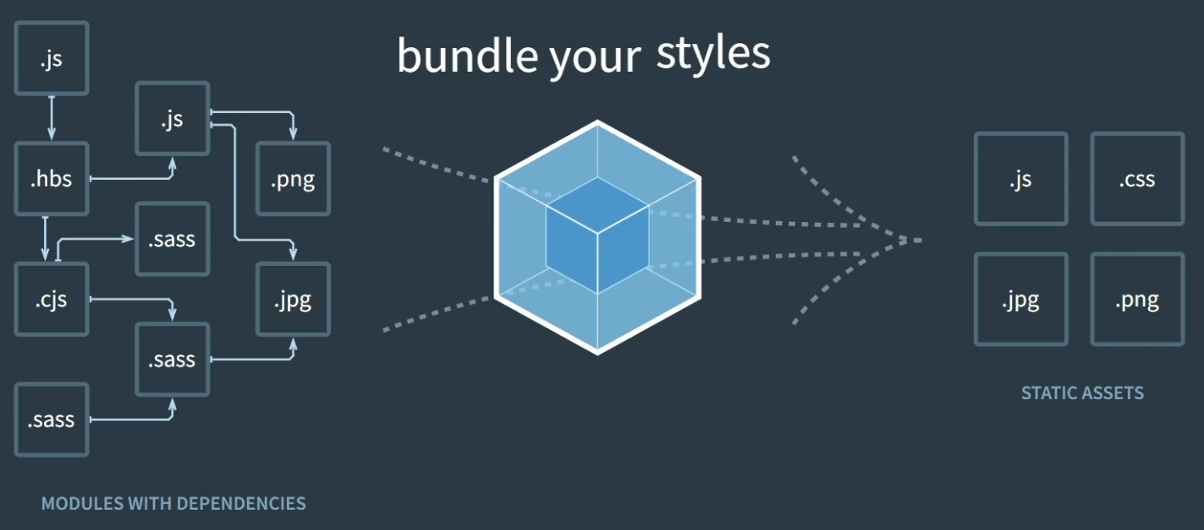
What is Webpack
It’s a Module bundler
Combines all your JS files into a single file that can be used by the browser.
Code Mentor Mauritius - React Sessions – Full Stack Web Development

Slide 6
JSX Syntax
ClassName instead of Class for setting css class to elements
JavaScript expression goes in: <p>{1+1}</p>
<div className=“class”><>
Variables in JSX
Let a=1; Return( <p>{a}</p>)
Ternary expressions
<p>{1+1===2 ? ‘Correct’ : ‘Incorrect’}</p>
React fragment <></> wrap required for displaying multiple elements
Code Mentor Mauritius - React Sessions – Full Stack Web Development

Slide 7
Components in React
Define a component in Src\App.js
function MyComponent() { return<p>HelloWorld</p>; }
Calling JSX components:
<MyComponent />
Component with Props
function MyComponentWithProp(props) {return <p>props</p>;}
<MyComponentWithProp name="Hello World!" />
<MyComponentWithProp name={1+1}/>
<MyComponentWithProp name=‘Hello World!’ />
<MyComponentWithProp name=‘BMW’ year={1+2}/>
Component name needs to start with a capital letter
Code Mentor Mauritius - React Sessions – Full Stack Web Development

Slide 8
Loops in React
function ListOfFruits() {
const data = [ { id: 1, name: "Apple" }, { id: 2, name: "Banana" }];
return ( <ul>{
))}</ul>);}
data.map(({ id, name }) => (<li key="{id}">name</li>
Code Mentor Mauritius - React Sessions – Full Stack Web Development

Slide 9
Conditional Rendering in React
Define a component in Src\App.js
function MyComponent(value) { return if(value==1){<p>HelloWorld}</p>;}
Calling the component
<MyComponent value="1" />
Code Mentor Mauritius - React Sessions – Full Stack Web Development

Slide 10
UseState Hook
import { useState } from "react";
React hooks
All functions starting with keyword use
State syntax example
Const [myCounter, setMyCounterValue] = useState(initialValue);
Let initialValue = 5;
return <>{myCounter}</>;
Inside a function:
setMyCounter((previousCount) => previousCount + 1)
setMyCounter(5)
Retrieves previous value of myCounter and adds 1 to it without refreshing the page
Sets value of myCounter as 5
The state of a react state object can only be changed using its own setter function; setMyCounterValue
Code Mentor Mauritius - React Sessions – Full Stack Web Development

Slide 11
Events
onClick{()=> alert(“clicked”)}
Arrow function passed in event
Code Mentor Mauritius - React Sessions – Full Stack Web Development

Slide 12
useEffect hook
Import {useEffect} from ‘react’;
Syntax: useEffect(()=>{console.log(‘page loaded’)})
Allows us to do something when an event happens
useEffect(()=>{console.log(‘page loaded’)}, [])
Dependency array, if left as empty array, useEffect is only called at the start
Code Mentor Mauritius - React Sessions – Full Stack Web Development

